Slide 1
DEPARTMENT OF COMPUTER SCIENCE AND ENGINEERING
Essay Grader
Deep Learning
Team Members
Name | Roll number
Vishwak Senan G | 201601110
Sundaramoorthy T | 201601100
Pranav Kumar K | 201601074
Team Supervisor
Name | Designation
Ms Dr D Jayashree | Professor
Zeroth Review : 01-10-2019

Slide 2
Objective of the Project
The primary objective of this project is to evaluate a given essay and provide suggestion to improve their English writing skill.
Our project seeks to help the audience who are looking to grade their essays according to international standards.

Slide 3
Introduction
Our project gives linguistic support to all the users and check the authenticity of the essay.
For example, if a GRE or IELTS candidate looking for someone to evaluate their essay, our project will help them with grading of their essay and provide suggestion to improve their writing skill. This certainly reduces time and risk of falsified evaluation of the passage.
To integrate the primary feature in other software, project’s primary service is hosted in cloud architecture and use API keys to access it securely.
This also provides an attractive dashboard to the users to keep track of their scores and their essays.
We evaluate the essay on these parameters.
Style continuity.
Coherence and cohesion.
Advanced lexical resources.
Grammatical range and accuracy.
Sentence complexity.

Slide 4
Project Feasibility Study
Project’s feature extraction goal is achieved using multiple trained neural network models where each model will do a particular task.
Python is used as our programming language since it has wide range of supports and package.
There are several international journals as reference to support our feasibility of our project within the speculated time. The journals are explained further in Literature Survey.
Framework:
Python Web Framework:
Django
UI Frameworks:
Bootstrap
React JS
Angular JS
jQuery
Chart JS
Python Package:
TensorFlow
Pandas

Slide 5
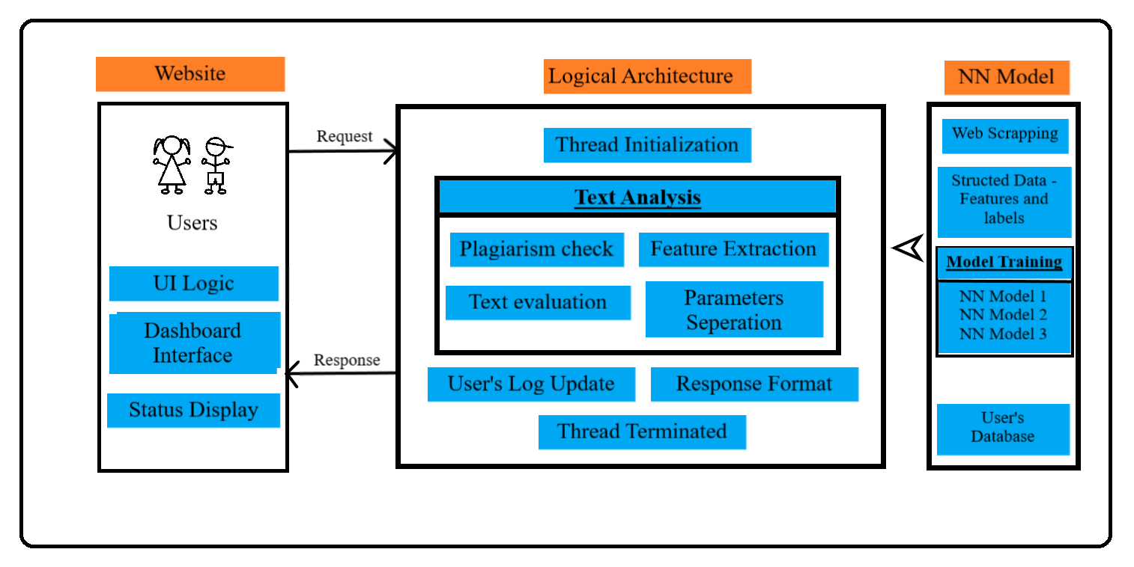
Architecture of Essay Grader

Slide 6
Literature Survey
Two international journals are used as our reference
Text Classification using Different Feature Extraction Approach.
Analysis of Text Categorization Represented With Word Embeddings Using Homogeneous Classifiers.
Paper 1 is published in IEEE on 06/06/2019 with DOI number 10.1109/eStream.2019.8732167 uses Term Frequency Inverse Document Frequency (TF-IDF) weighing scheme to extract feature’s advantage and uses Latent Semantic Analysis (LSA) and Linear Discriminant Analysis (LDA) to overcome TF-IDF’s limitation.
Paper 2 is published in IEEE on 29/07/2019 with DOI number 10.1109/INISTA.2019.8778329 uses Word embeddings and ensemble strategies to classify text with much higher accuracy. Word embedding dual neural network word2vector model to map words to real time integers according to syntax and semantic relativity. Ensemble strategies uses voting system to choose a model which provides much more accuracy and less training time.

